Slide 1
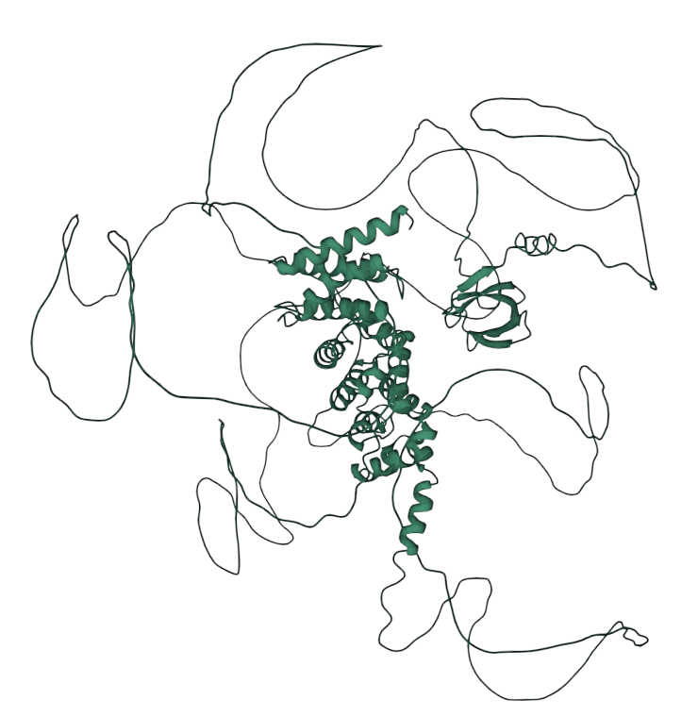
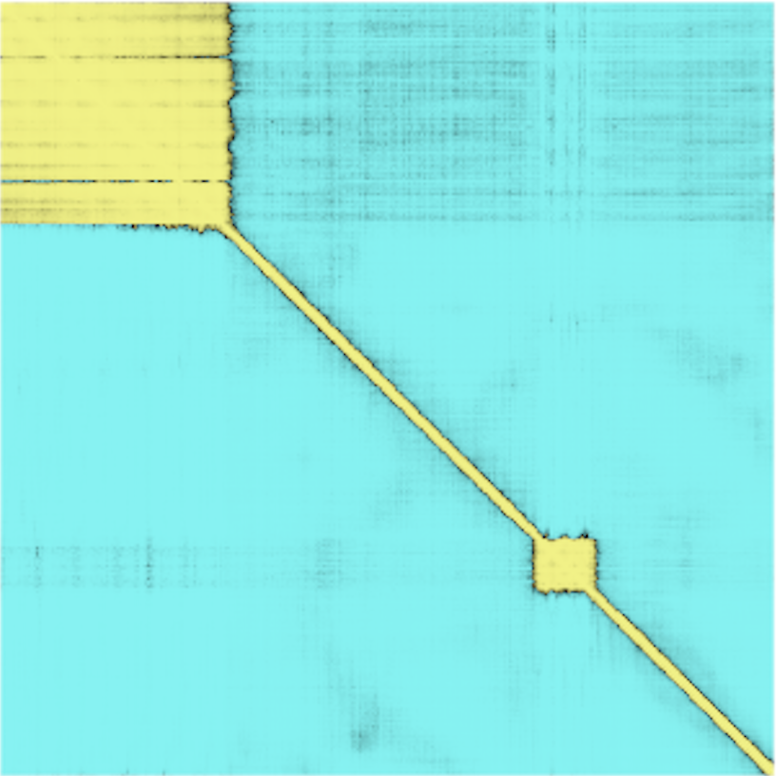
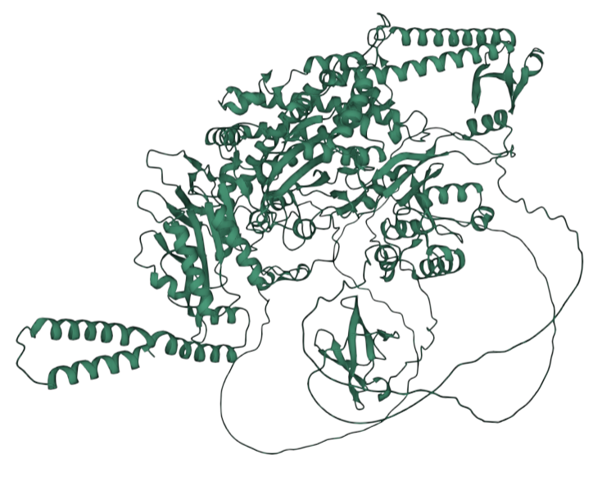
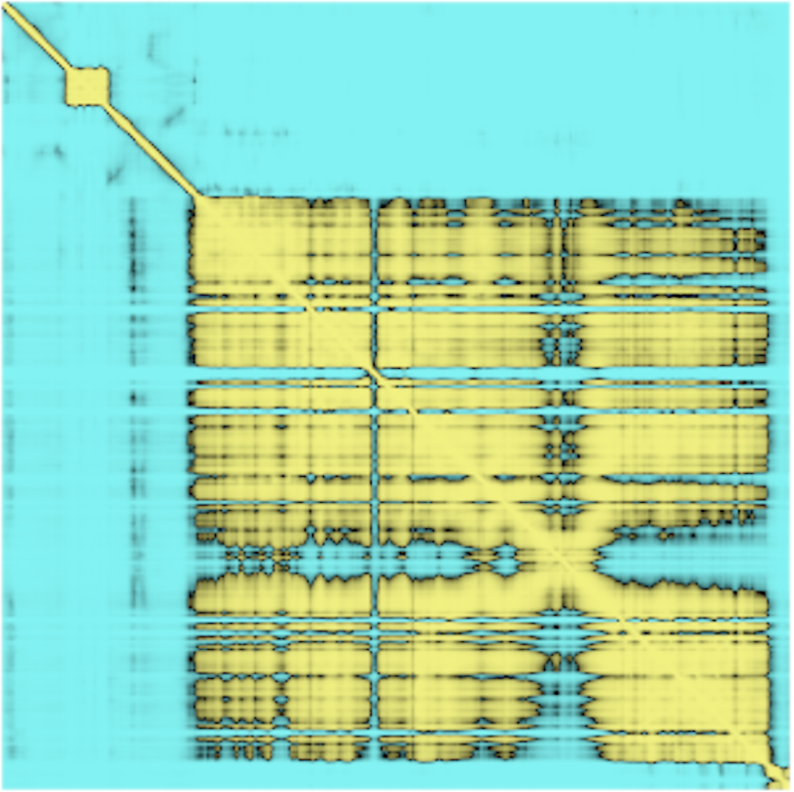
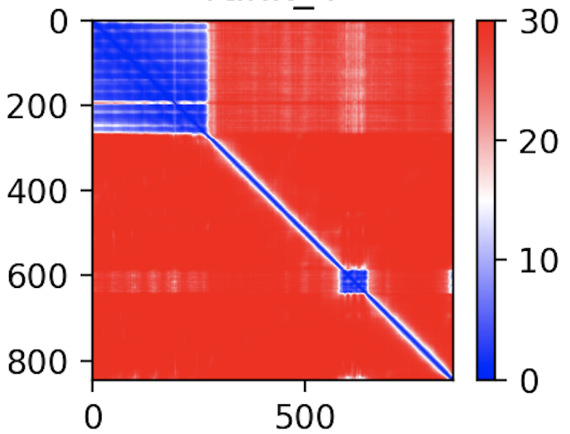
A
A. thaliana PDS5C
B
Gene bodies
Intergenic
0
400
Aligned residue
Tudor
(Confirmed H3K4me1 binding)
Tudor
PDS5C enrichment (rank)
800
400
800
0
Scored residue
0
15
30
Expected position error
(Ångströms)
A. thaliana MSH6
“Essential” genes
“Non-essential” genes
C
0
Tudor
600
Aligned residue
PDS5C enrichment (rank)
1.2k
600
1.2k
0
Scored residue
Tudor
0
15
30
H3K4me1 enrichment (rank)
Expected position error
(Ångströms)
D
G
H
E
F
Benchmarking
C
A. thal.
MSH6
O. sativa
PDS5C
me1
A. thal.
PDS5C
O. sativa
MSH6
I
J
me2
me2
me3
me3
Figure 1. Arabidopsis thaliana and Oryza sativa PDS5C and MSH6 Tudor domains affinity to H3K4 methylation. A-B, Alphafold2 structure of PDS5C and MSH6 protein from A. thaliana indicates Tudor domain is tethered to active domains C, ClustalW alignment of Tudor domains. Red arrows mark residues shown to be important for H3K4me1 specific binding, and yellow arrows mark residues important to interact with H3R2 (Niu et al. 2021) D, Aromatic cage and H3K4me1in experimental structure of At_PDS5C (PDB: 7DE9) (Niu et al. 2021) highlighting in yellow the distances to the center of the three aromatic rings. E, % of models generated with an average distance < 6Å. Docking benchmarking in relation to ITC experimental results from A. thal PDS5C. Average distance from the side chain nitrogen of H3K4 to the center of aromatic rings forming the aromatic cage (see B) of top 1,000 models (10%) based on Rosetta total score after docking H3 tail peptides in different methylation states to the Tudor domains of PDS5C and MSH6 from both A. thaliana and O. sativa. The dashed line marks the average distance in the experimental structure as a reference. F-I, FlexPepDock models of the H3K4me1 peptide in the aromatic cage of Tudor domains of At_PDS5C, At_MSH6, Os_PDS5C and OS_MSH6. Residues interacting with H3K4me1 are amplified in the left boxes. Residues interacting with H3R2 are highlighted in the right boxes.

Slide 2
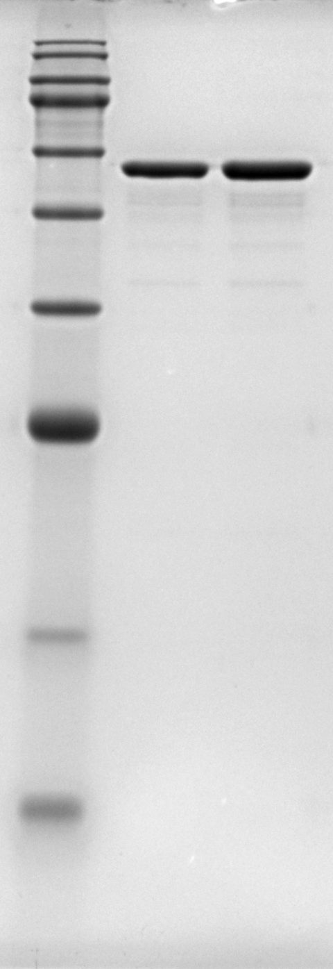
Domain composition of purified proteins
MSH6 Tudor domain
A
His₆-tag
MBP
GS linker
HRV3C protease RS
SDS-PAGE with CBB staining
H3K4me1-binding aromatic residues (Arabidopsis)
B
C
Arabidopsis MSH6 Tudor wildtype
Arabidopsis MSH6 Tudor w/ 3A Mutation
3A mutant
wild type
Markers
kDa
75
63
48
35
28
17
10
Figure 2. Experimental validation of Arabidopsis MSH6 Tudor domain affinity to H3K4 methylation. A) Domain and sequence of purified protein used in fluorescence polarization (FP). The 3Amut protein only replaces aromatic residues that bind H3K4me1 from the wildtype Tudor domain with Alanine. B) SDS-PAGE confirming purity. C) FP results (3 replicates per experiment). Points represent mean and error bars standard deviations.

Slide 3
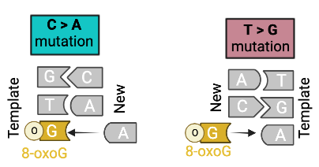
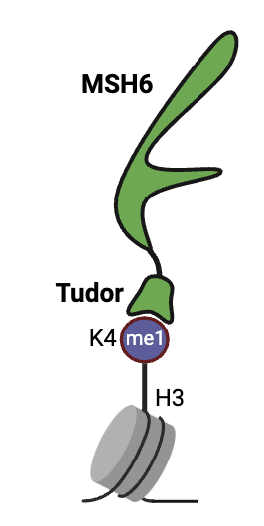
A
B
msh6
C
WT
msh6
D
SALK_037557
MSH6 (AT4G020270)
SALK_089638
somatic
8 msh6/msh6, 2 wt/msh6, 7 wt/wt
Individual, whole, 3 week old rosettes
Whole genome sequencing ~ 250X depth
Strelka2: Tumor vs Normal (all vs. all)
Variants called in only 1 sample &
PASS for all 16 ”NORMAL” comparisons &
Distance to nearest mutation >1000 bp &
Total read depth >150 &
Alt read support > 5
Somatic (X² p<0.001, alt reads < 50%)
somatic
het
Filters
hom
hom
het
E
All WT lines combined
All mh6 lines combined
F
Overview: Regions preferentially repaired by MSH6 in Arabidopsis
X² = 34
p = 2 x 10⁻⁸
X² = 27
p = 1 x 10⁻⁶
Test combined data
msh6:WT mutations
msh6:WT mutations
Figure 3. Somatic mutations in MSH6 knockout lines. A, Diagram representing MSH6 mutant SALK insertions used to phenotype mutation rates in MSH deficient lines. General pipeline for Somatic mutation experimental design and strict variant calling using Strelka2. B, Alternative allele frequency of mutations found in wt/wt+wt/msh6 and msh6/msh6 lines. Total number of mutations (n) are 127 and 322 respectively. C, mutation signature of wt/wt+wt/msh6 and msh6/msh6 with msh6/msh6 showing D, expected effects of unrepaired mismatches between adenine and oxidized guanine. E, Proportion of mutations distribution in gene bodies in wt/wt+wt/msh6 and msh6/msh6 lines. F, msh6/msh6 to wt/wt+wt/msh6 mutation ratio in different genomic features and G, in genome regions grouped by H3K4me1 ChIP-seq.
E
Somatic
Germline (het+hom)
Test sample level data

Slide 4
A
Mutation observed in 200bp windows (binomial reg.)
Synonymous mutation/CDS bp genes (linear reg.)
ChIP from Lu et al. 2019
* (weak, p<0.03)
H3K4me1
H3K4me1
H3K4me1
H3K4me1
B
Peaks from RiceENCODE
Xie et al. 2021
C
D
E
H3K4me1
Z score
H3K4me1
H3K4me1
F
p<2e-16
G
H
H3K4me1
-29%
*
-22%
-19%
*
H3K4me1
H3K4me1
Figure 4. Spectra and distribution of germline SBS mutations in fast neutron rice. A, Frequency of mutations in trinucleotide contexts and correlation with de novo germline mutations in A. thaliana (r>0.8, p<2x10⁻¹⁶) (Weng et al. 2019, Monroe et al. 2022). B, Results from logistic regression modeling mutation probability in 100bp windows as a function of overlap with epigenomic marks around genes in rice. C, Mutation rates in relation to gene bodies in rice. D, Mutation rates in relation to H3K4me1 peak regions in rice. E, H3K4me1 peaks regions distribution in gene bodies in rice. D-E, Black line shows null expectation (mutations around randomized peaks). F, Mutation rates in genic, intergenic, and TE regions. G, H3K4me1 enrichment and gene body mutation rates in genes annotated as expressed (Y) and non-expressed (N) in rice. H, H3K4me1 enrichment and gene body mutation rates in genes subject variable degrees of purifying selection (low vs high Pn/Ps) in 3,010 natural accessions of rice.

Slide 5
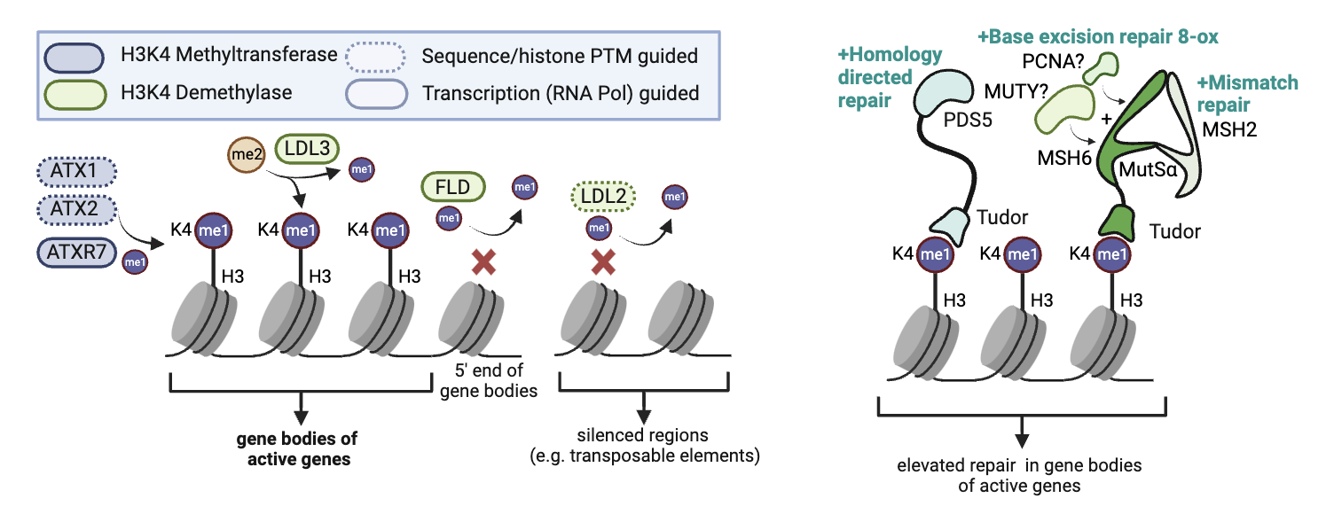
H3K4me1 enrichment
DNA repair
Figure 5. Emerging mechanistic model of H3K4me1-targeted DNA repair in plants. ATX1, ATX2, ATXR7 are responsible for the enrichment of H3K4me1 in the gene bodies of active genes (Oya et al. 2021). Tudor domain of PDS5C binds H3K4me1 and facilitates homology directed repair (HDR) (Niu et al. 2021). Other repair genes including PDS5 paralogs and MSH6 (responsible for mismatch repair – MMR) also contain functionally similar Tudor domains, with H3K4me1 targeting potential.

Slide 6
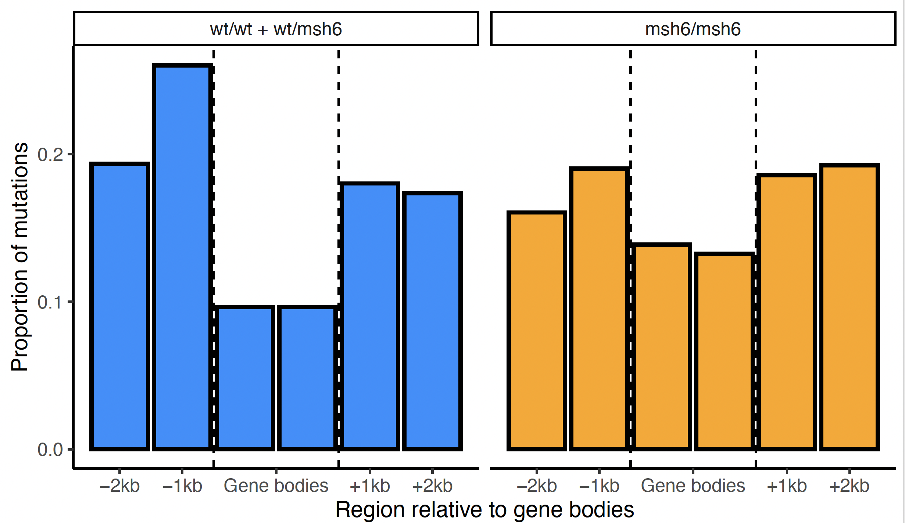
A
SALK_089638
B
C
D
SALK_037557
MSH6 (AT4G020270)
n=127
n=322
8 msh6/msh6, 2 wt/msh6, 7 wt/wt
Individual, whole, 3 week old rosettes
Whole genome sequencing ~ 250X depth
Strelka2: Tumor vs Normal (all vs. all)
Variants called in only 1 sample &
PASS for all 16 ”NORMAL” comparisons &
Distance to nearest mutation >1000 bp &
Total read depth >150 &
Alt read support > 5
Somatic (X² p<0.001, alt reads < 50%)
Filters
E
F
X² = 15.824, df = 2
p-value = 0.0003663
G
X² = 24.82, df = 2
p-value = 4e-06
Figure 3. Somatic mutations in MSH6 knockout lines. A, Diagram representing MSH6 mutant SALK insertions used to phenotype mutation rates in MSH deficient lines. General pipeline for Somatic mutation experimental design and strict variant calling using Strelka2. B, Alternative allele frequency of mutations found in wt/wt+wt/msh6 and msh6/msh6 lines. Total number of mutations (n) are 127 and 322 respectively. C, mutation signature of wt/wt+wt/msh6 and msh6/msh6 with msh6/msh6 showing D, expected effects of unrepaired mismatches between adenine and oxidized guanine. E, Proportion of mutations distribution in gene bodies in wt/wt+wt/msh6 and msh6/msh6 lines. F, msh6/msh6 to wt/wt+wt/msh6 mutation ratio in different genomic features and G, in genome regions grouped by H3K4me1 ChIP-seq.

Slide 7
A
c
d
X² = 126.9, p < 2.2x10¹⁶
I think the one that I left out is the less relevant to the analysis, but I don’t know… I just took it out to make it symmetrical.
e
f
a
b
B
C
D
. p<2x10⁻¹⁶
E
Figure 2. PDS5C targets H3K4me1 and is associated with lower mutation rates. A, ChIP-seq analysis of PDS5C in A thaliana, cohesion cofactor involved in HDR (Niu et al. 2021). Letters represent TukeyHSD contrast at p=0. Upstream/downstream = 1000bp. B, Features marked by PDS5C experience reduced germline mutation rates in A. thaliana. C, Gene bodies of genes with elevated H3K4me1 have greater levels of PDS5C, as do D, essential genes, and E, genes under stronger purifying selection. Pn/Ps = Non-synonymous /synonymous polymorphisms in A. thaliana populations. Mean +- SE for percentiles shown. Pearson correlation (r) reflects entire dataset. P<2x10⁻¹⁶ for all.

Slide 8
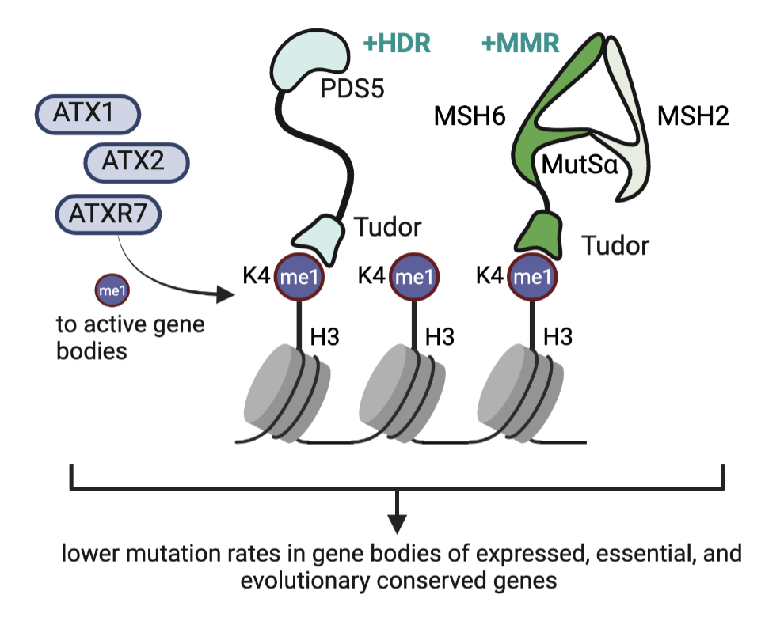
Figure 5. Emerging mechanistic model of H3K4me1-targeted DNA repair in plants. ATX1, ATX2, ATXR7 are responsible for the enrichment of H3K4me1 in the gene bodies of active genes (Oya et al. 2021). Tudor domain of PDS5C binds H3K4me1 and facilitates homology directed repair (HDR) (Niu et al. 2021). Other repair genes including PDS5 paralogs and MSH6 (responsible for mismatch repair – MMR) also contain functionally similar Tudor domains, with H3K4me1 targeting potential.

Slide 9
A
*** P<2e-16
NS
Figure S1. Non-synonymous to synonymous ratios. The non-synonymous to synonymous ratio was significantly lower (p<2.x10⁻¹⁶) in natural populations compared to mutation accumulation lines and neutral expectation. The non-synonymous to synonymous ratio was similar in mutation accumulation lines to neutral expectation.
Figure S1. Non-synonymous to synonymous ratios. The non-synonymous to synonymous ratio was significantly lower (p<2.x10⁻¹⁶) in natural populations compared to mutation accumulation lines and neutral expectation. The non-synonymous to synonymous ratio was similar in mutation accumulation lines to neutral expectation.

Slide 10
A
Z score
Z score
Z score
Z score
B
Figure S2. Relationships between epigenomic features, mutation and gene bodies A, Results from logistic regression modeling mutation probability in 100bp windows as a function of overlap with epigenomic marks around genes in rice. Four panels reflect various subsets of data to test for effects of cytosine deamination in transposable elements as alternative explanation, selection, or mapping. B, Mutation rates in relation to gene bodies in rice.
Figure S1. Non-synonymous to synonymous ratios. The non-synonymous to synonymous ratio was significantly lower (p<2.x10⁻¹⁶) in natural populations compared to mutation accumulation lines and neutral expectation. The non-synonymous to synonymous ratio was similar in mutation accumulation lines to neutral expectation.

Slide 11
A
B
-22%
-19%
C
-29%
Marked genes
Marked genes
Marked genes
Figure S3. Expressed and conserved genes and H3K4me1 marked genes have lower mutation rates in rice A, synonymous mutation rates, non-synonymous to synonymous de novo mutation ratio in mutation accumulation lines (MA N/S) in expressed vs non-expressed genes and B, in genes subject variable degrees of purifying selection (low vs high Pn/Ps) in 3,010 natural accessions of rice. C, mutation rates, non-synonymous to synonymous de novo mutations in mutation accumulation lines (MA N/S) in H3K4me1 non-marked genes (FALSE) and marked genes (TRUE).

Slide 12
Single variable binomial (logistic) regression
Multiple regression, binomial with AIC model selection
Multiple regression, Poisson
Multiple regression, linear
Multiple regression, Poisson, with AIC model selection
Multiple regression, linear, with AIC model selection
Figure S4. Supplementary models: Relationships between epigenomic features, mutation and gene bodies.
I simplified and only show the extra modelling approaches for all SBS (instead of all the subsets like non C.T)

Slide 13
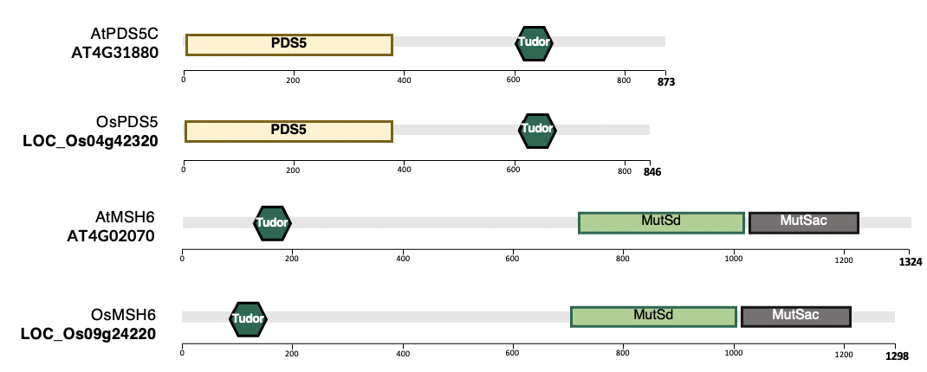
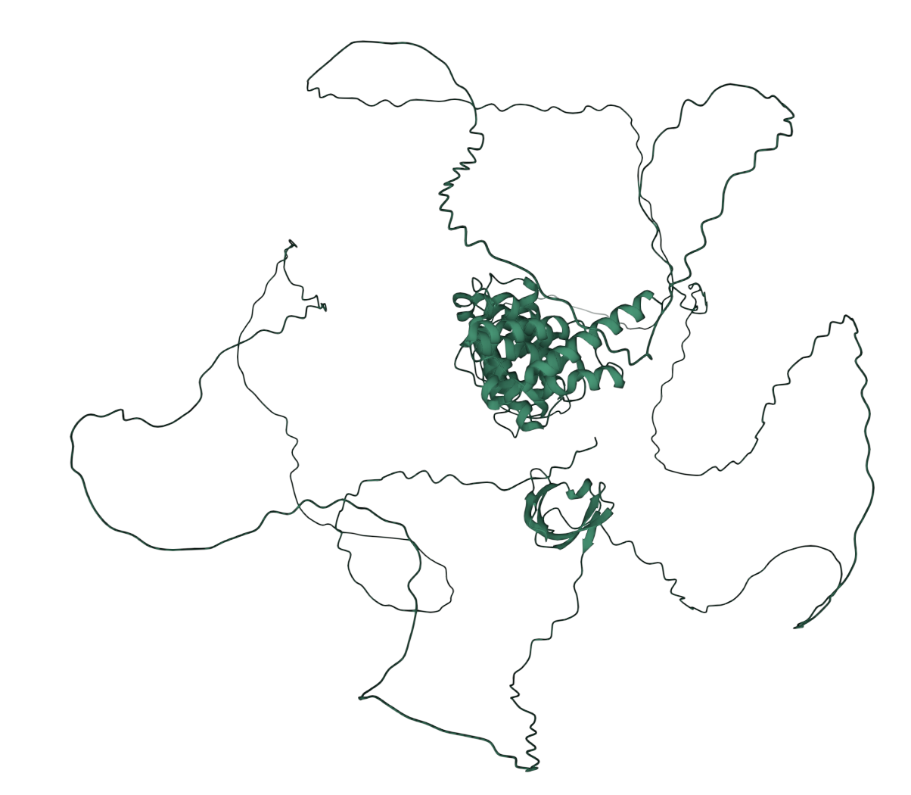
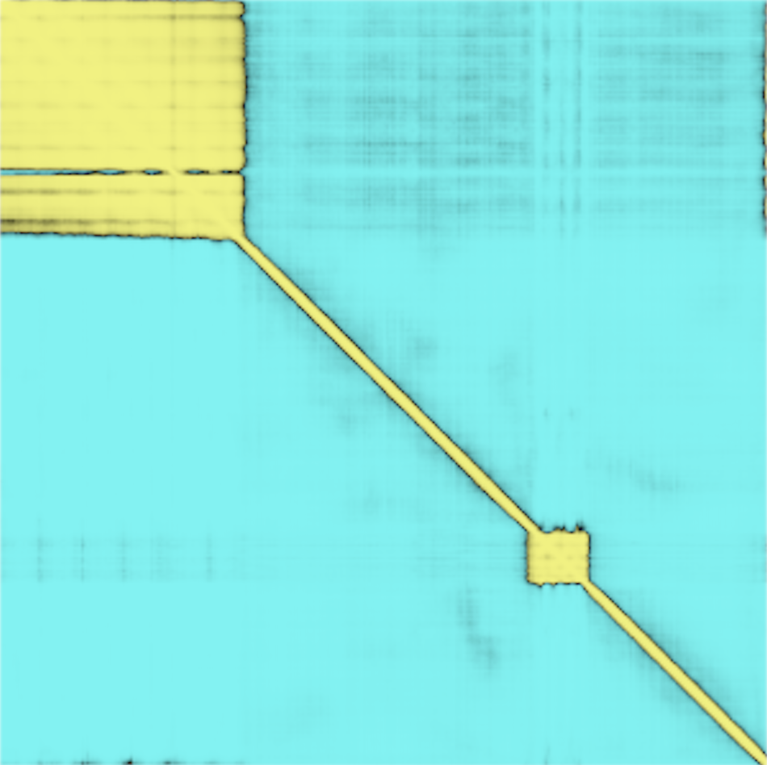
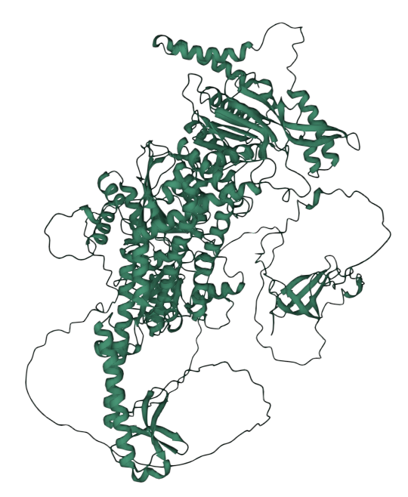
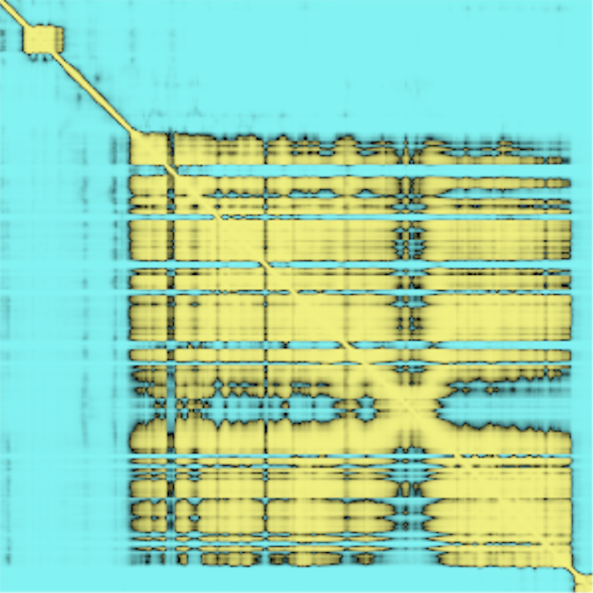
A
A. thaliana PD5C Tudor domain
B
[LVGSRIKVWWPMDQAYYKGVVESYDAAKKKHLVIYDDGDQEILYLKNQKW]
blastp A. thaliana
29 genes
Gene ontology
DNA repair
p=1x10⁻¹¹
AT5G47690 | PDS5A
AT1G77600 | PDS5B
AT4G31880 | PDS5C
AT1G80810 | PDS5D
AT1G15940 | PDS5E
AT4G32620 | EPCR1
AT4G32970 | BRISC/BRCA1-A
AT5G10950 | Tudor/PWWP/MBT
AT4G02070 | MSH6
Cohesion/homology directed repair
Mismatch repair
C
OsPDS5 (LOC_Os04g42320)
D
OsMSH6(LOC_Os09g24220)
0
0
Tudor
Aligned residue
600
400
Aligned residue
800
Tudor
1.2k
0
400
800
0
600
1.2k
Scored residue
Scored residue
0
15
0
15
30
Tudor
30
Expected position error
(Ångströms)
Expected position error
(Ångströms)
Tudor
Figure S5. Multiple repair pathways with H3K4me1 targeting potential via Tudor domains. A, Results from blastp of PCDS5C Tudor domain, which has confirmed H3K4me1 binding specificity (Niu et al. 2021) identified 29 genes. Nine of these are annotated as having DNA repair function (significant enrichment by gene ontology analysis). ,B, Domain prediction of A. thaliana and O. sativa putative orthologs of PDS5C and MSH6 genes. C-D, Structure of PDS5C and MSH6 protein from Alphafold2 indicates Tudor domain is tethered to active domains structure in putative O. sativa orthologs.
A. thaliana PDS5C
0
873
Arath pds5c
Uniprot: Q8GUP3
GeneID: AT4G31880 873 total
Pds5 2-264
Tudor 605-659
Rice pds5
GeneID: LOC_Os04g42320
846 total
Pds5 29-246
Tudor 601-634
LOC_Os04g42320
Tudor
Arath msh6
Uniprot: O04716
GeneID: AT4G02070
1324 total
Tudor 121-179
MutSd 716-1056
MutSac 1076-1268
Rice msh6
Uniprot:A3BYP3
GeneID: LOC_Os09g24220
1293 total
Tudor 75-133
MutSd 676-1017
MutSac 1037-1228
Active domains
E=7.38x10⁻⁶¹
E=7.38x10⁻⁶¹
AtPDS5C
AT4G31880
Tudor
1->300
0
PDS5
400
600
200
800
873
OsPDS5
LOC_Os04g42320
PDS5
Tudor
0
200
400
600
800
846
AtMSH6
AT4G02070
Tudor
MutSd
MutSac
0
200
400
600
800
1000
1200
1324
OsMSH6
LOC_Os09g24220
Tudor
MutSd
MutSac
0
200
400
600
800
1000
1200
1298

Slide 14
Figure S6. AlphaFold predictions of Tudor domains. AlphaFold models of A. thaliana and O. sativa MSH6 and O. sativa PDS5C Tudor are shown superimposed onto the experimental structure of A. thaliana PDS5C Tudor domain (PDB:7DE9) (Niu et al. 2021).

Slide 15
A
B
C
D
Figure S7. The average distance (in Å) distribution to the aromatic cage in FlexPepDock models of the different H3K4 marks tested, for; A, A. thaliana PDS5C Tudor experimental structure (PDB:7de9) B, O. sativa PDS5C Tudor Alphafold model C, A. thaliana MSH6 Tudor Alphafold model D, O. sativa MSH6 Tudor Alphafold model. A-D, The red line marks the threshold of 6Å (defining the H3K4 inside the aromatic cage).

Slide 16
A
n=1
n=7
B
n=6
germline
n=1
n=2
C
D
X-squared = 11.057, df = 2, p-value = 0.003971
X-squared = 9.0427, df = 2, p-value = 0.01087
Figure S7. A, genic/non-genic mutations in MSH6 knockout lines SALK_089638 and SALK_037557. B, frequency of alternative alleles distribution detected by Strelka2 variant caller. C, Germline mutations signature in MSH6 knockout lines and WT. D, msh6/wt mutation ratio in different genomic features and in different H3K4me1 ChIP-seq %ile for de novo germline mutations.

Slide 17
A
A. thaliana PD5C Tudor domain
B
[LVGSRIKVWWPMDQAYYKGVVESYDAAKKKHLVIYDDGDQEILYLKNQKW]
A. thaliana PDS5C
0
873
blastp A. thaliana
29 genes
Gene ontology
DNA repair
p=1x10⁻¹¹
LOC_Os04g42320
Tudor
Active domains
E=7.38x10⁻⁶¹
E=7.38x10⁻⁶¹
AT5G47690 | PDS5A
AT1G77600 | PDS5B
AT4G31880 | PDS5C
AT1G80810 | PDS5D
AT1G15940 | PDS5E
AT4G32620 | EPCR1
AT4G32970 | BRISC/BRCA1-A
AT5G10950 | Tudor/PWWP/MBT
AT4G02070 | MSH6
Cohesion/homology directed repair
Mismatch repair
C
A. thaliana PDS5C
0
D
A. thaliana Mismatch repair MSH6
0
Tudor
400
Aligned residue
600
Aligned residue
Tudor
(Confirmed H3K4me1 binding)
800
Tudor
0
400
800
1.2k
Scored residue
0
600
1.2k
0
15
30
Scored residue
Expected position error
(Ångströms)
Tudor
0
15
30
Rice PDS5C (LOC_Os04g42320)
Expected position error
(Ångströms)
0
Rice Mismatch repair MSH6
Aligned residue
0
Tudor
400
Tudor
600
800
Aligned residue
0
400
800
Tudor
Scored residue
1.2k
0
15
30
Expected position error
(Ångströms)
0
600
1.2k
Tudor
Scored residue
0
15
30
Expected position error
(Ångströms)
Alternative Figure S4. Multiple repair pathways with H3K4me1 targeting potential via Tudor domains. A, Results from blastp of PCDS5C Tudor domain, which has confirmed H3K4me1 binding specificity (Niu et al. 2021) identified 29 genes. Nine of these are annotated as having DNA repair function (significant enrichment by gene ontology analysis). , B, Protein domain structure and comparison of A. thaliana PDS5C and putative rice ortholog LOC_Os4g43220, and A. thaliana MSH6 and putative rice ortholog LOC_Os09g24220. C-D, Structure of PDS5C and MSH6 protein from Alphafold2 indicates Tudor domain is tethered to active domains and similar structure observed in putative rice orthologs.

Slide 18
A
C
Benchmarking
me1
r=.999
A. thal.
PDS5C
A. thal.
MSH6
rice
PDS5C
rice
MSH6
.5 Å
me1
.5 Å
me2
me2
me3
me3
Alternative Figure 3. Arabidopsis thaliana and Oryza sativa PDS5C and MSH6 Tudor domains affinity to H3K4 methylation. A, ClustalW alignment of Tudor domains. Red arrows mark residues shown to be important for H3K4me1 specific binding, and yellow arrows mark residues important to interact with H3R2 (Niu et al. 2021) B, Aromatic cage and H3K4me1in experimental structure of At_PDS5C (PDB: 7DE9) (Niu et al. 2021) highlighting in yellow the distances to the center of the three aromatic rings. C, % of models generated with an average distance < 6 A. Docking benchmarking in relation to ITC experimental results from A. thal PDS5C. Average distance from the side chain nitrogen of H3K4 to the center of aromatic rings forming the aromatic cage (see B) of top 1,000 models (10%) based on Rosetta total score after docking H3 tail peptides in different methylation states to the Tudor domains of PDS5C and MSH6 from both A. thaliana and O. sativa. The dashed line marks the average distance in the experimental structure as a reference. D-G, FlexPepDock models of the H3K4me1 peptide in the aromatic cage of Tudor domains of At_PDS5C, At_MSH6, Os_PDS5C and OS_MSH6. Residues interacting with H3K4me1 are amplified in the left boxes. Residues interacting with H3R2 are highlighted in the right boxes.

Slide 19
A
A. thaliana PD5C Tudor domain
B
OsPDS5 (LOC_Os04g42320)
[LVGSRIKVWWPMDQAYYKGVVESYDAAKKKHLVIYDDGDQEILYLKNQKW]
0
blastp A. thaliana
29 genes
Gene ontology
DNA repair
p=1x10⁻¹¹
Aligned residue
AT5G47690 | PDS5A
AT1G77600 | PDS5B
AT4G31880 | PDS5C
AT1G80810 | PDS5D
AT1G15940 | PDS5E
AT4G32620 | EPCR1
AT4G32970 | BRISC/BRCA1-A
AT5G10950 | Tudor/PWWP/MBT
AT4G02070 | MSH6
400
Cohesion/homology directed repair
Tudor
800
400
800
0
Scored residue
Tudor
0
15
30
Mismatch repair
Expected position error
(Ångströms)
C
OsMSH6(LOC_Os09g24220)
0
Tudor
Alternative Figure S5. Multiple repair pathways with H3K4me1 targeting potential via Tudor domains. A, Results from blastp of PCDS5C Tudor domain, which has confirmed H3K4me1 binding specificity (Niu et al. 2021) identified 29 genes. Nine of these are annotated as having DNA repair function (significant enrichment by gene ontology analysis). B-C, Structure of PDS5C and MSH6 protein from Alphafold2 indicates Tudor domain is tethered to active domains structure in putative O. sativa orthologs.
600
Aligned residue
1.2k
600
1.2k
0
Scored residue
0
15
30
Expected position error
(Ångströms)
Tudor

Slide 20
SALK_037557
SALK_089638
B
C
A
MSH6 (AT4G020270)
n=127
n=322
8 msh6/msh6, 2 wt/msh6, 7 wt/wt
Individual, whole, 3 week old rosettes
Whole genome sequencing ~ 250X depth
Strelka2: Tumor vs Normal (all vs. all)
PASS for all 16 ”NORMAL” comparisons &
Distance to nearest mutation >1000 bp &
Total read depth >150 &
Alt read support > 5
Somatic (X² p<0.001, alt reads < 50%)
Filters
D
E
X² = 15.824, df = 2
p-value = 0.0003663
F
X² = 24.82, df = 2
p-value = 4e-06
Alternative Figure 4. Somatic mutations in MSH6 knockout lines. A, Diagram representing MSH6 mutant SALK insertions used to phenotype mutation rates in MSH deficient lines. General pipeline for Somatic mutation experimental design and strict variant calling using Strelka2. B, Alternative allele frequency of mutations found in wt/wt+wt/msh6 and msh6/msh6 lines. Total number of mutations (n) are 127 and 322 respectively. C, mutation signature of wt/wt+wt/msh6 and msh6/msh6 with msh6/msh6 showing expected effects of unrepaired mismatches between adenine and oxidized guanine. D, Proportion of mutations distribution in gene bodies in wt/wt+wt/msh6 and msh6/msh6 lines. E, msh6/msh6 to wt/wt+wt/msh6 mutation ratio in different genomic features and F, in genome regions grouped by H3K4me1 ChIP-seq.

Slide 21
SALK_037557
SALK_089638
A
MSH6 (AT4G020270)
C
8 msh6/msh6, 2 wt/msh6, 7 wt/wt
Individual, whole, 3 week old rosettes
Whole genome sequencing ~ 250X depth
Strelka2: Tumor vs Normal (all vs. all)
PASS for all 16 ”NORMAL” comparisons &
Distance to nearest mutation >1000 bp &
Total read depth >150 &
Alt read support > 5
Somatic (X² p<0.001, alt reads < 50%)
Filters
B
D
X² = 15.824, df = 2
p-value = 0.0003663
E
X² = 24.82, df = 2
p-value = 4e-06
n=127
n=322
Alternative Figure 4. Somatic mutations in MSH6 knockout lines. A, Diagram representing MSH6 mutant SALK insertions used to phenotype mutation rates in MSH deficient lines. General pipeline for Somatic mutation experimental design and strict variant calling using Strelka2. B, Alternative allele frequency of mutations found in wt/wt+wt/msh6 and msh6/msh6 lines. Total number of mutations (n) are 127 and 322 respectively. C, Proportion of mutations distribution in gene bodies in wt/wt+wt/msh6 and msh6/msh6 lines. D, msh6/msh6 to wt/wt+wt/msh6 mutation ratio in different genomic features and E, in genome regions grouped by H3K4me1 ChIP-seq.

Slide 22
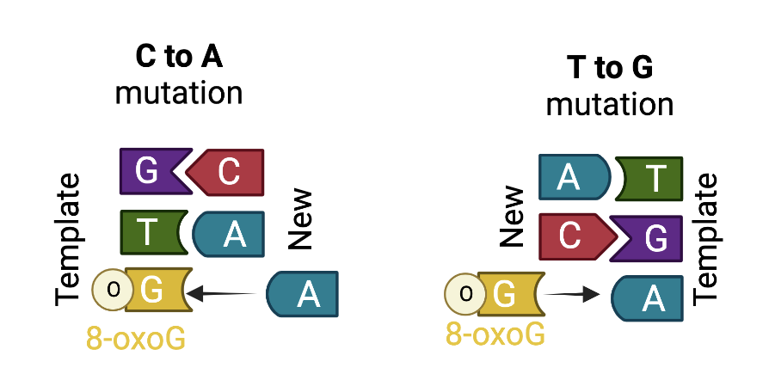
A
B
Alternative Figure 4. Somatic mutations in MSH6 knockout lines. A, mutation signature of wt/wt+wt/msh6 and msh6/msh6 with msh6/msh6 showing B, expected effects of unrepaired mismatches between adenine and oxidized guanine.

Slide 23
Purification scheme
Cell: BL21(DE3) codonplusRIL
Scale: 5 L culture with LB medium
Protein expression (0.5 mM IPTG, O/N)
Cell lysis by sonication
Ni-NTA agarose column
Anion exchange (RESOURCE Q 150-400 mM NaCl)
Flow-through
Gel filtration (Superdex200)
Concentration by ultrafiltration (Amicon Ultra 30k)

Slide 24
A
A. thaliana PDS5C
A
c
d
X² = 126.9, p < 2.2x10¹⁶
0
e
400
b
f
Aligned residue
a
Tudor
(Confirmed H3K4me1 binding)
800
Tudor
0
400
800
Scored residue
B
C
0
15
30
Expected position error
(Ångströms)
B
A. thaliana MSH6
0
Tudor
D
E
600
p<2x10⁻¹⁶
Aligned residue
1.2k
600
1.2k
0
Scored residue
0
15
30
Tudor
Expected position error
(Ångströms)
C
F
G
D
E
Benchmarking
C
A. thal.
MSH6
O. sativa
PDS5C
me1
A. thal.
PDS5C
O. sativa
MSH6
H
I
me2
me2
me3
me3
Figure 3. Arabidopsis thaliana and Oryza sativa PDS5C and MSH6 Tudor domains affinity to H3K4 methylation. A-B, Alphafold2 structure of PDS5C and MSH6 protein from A. thaliana indicates Tudor domain is tethered to active domains C, ClustalW alignment of Tudor domains. Red arrows mark residues shown to be important for H3K4me1 specific binding, and yellow arrows mark residues important to interact with H3R2 (Niu et al. 2021) D, Aromatic cage and H3K4me1in experimental structure of At_PDS5C (PDB: 7DE9) (Niu et al. 2021) highlighting in yellow the distances to the center of the three aromatic rings. E, % of models generated with an average distance < 6Å. Docking benchmarking in relation to ITC experimental results from A. thal PDS5C. Average distance from the side chain nitrogen of H3K4 to the center of aromatic rings forming the aromatic cage (see B) of top 1,000 models (10%) based on Rosetta total score after docking H3 tail peptides in different methylation states to the Tudor domains of PDS5C and MSH6 from both A. thaliana and O. sativa. The dashed line marks the average distance in the experimental structure as a reference. F-I, FlexPepDock models of the H3K4me1 peptide in the aromatic cage of Tudor domains of At_PDS5C, At_MSH6, Os_PDS5C and OS_MSH6. Residues interacting with H3K4me1 are amplified in the left boxes. Residues interacting with H3R2 are highlighted in the right boxes.

